Slide 1
AWS Containers Roadshow LATAM 2022

Slide 2
Flexible Compute
Cost Optimization
Douglas Ramiro
Sr. Solutions Architect Flexible Compute

Slide 3
Agenda
EC2 Spot
EKS and EC2 Spot
Scaling
Tools
Graviton

Slide 4
EC2 Spot

Slide 5





EC2 Spot knowledge check
Common EC2 Spot myths-busted!
Pricing for Spot is published by AWS and determined by long term supply and demand trends (slow and predictable)
Spot is for customers looking to optimize their EC2 expenses for Spot-friendly workloads
Spot instance prices are based on customer bidding?
Spot is for customers looking for “extreme low cost” solutions
Integrations with AWS Services and our partners make it much easier to adopt Spot
Spot is timely and difficult to implement
Spot is appropriate for non-production and production workloads
Spot instances are specific types of instances in some AWS regions
Spot instances are the same instance types as as On Demand and available in All Regions
Spot is intended for non-production workloads

Slide 6
Amazon EC2 purchase options
On-Demand
Pay for compute capacity by the second with no long-term commitments
Spiky workloads, to define needs
Reserved Instances
Make a 1 or 3 year commitment and receive a significant discount off On-Demand prices
Committed and steady-state usage
Savings Plan
Same great discounts as Amazon EC2 RIs with more flexibility
Committed flexible access to compute
Spot Instances
Spare Amazon EC2 capacity at savings of up to 90% off On-Demand prices
Fault-tolerant, flexible, stateless workloads

Slide 7
What are EC2 Spot Instances?
Spot Instances are spare EC2 capacity made available to customers as a purchase option with steep discounts
Spare EC2 capacity
Same infrastructure as On-Demand
Up to 90% discount over On-Demand pricing
Spot price is based on long-term supply and demand trends of EC2 instances (no bidding)
Interruptible
Spot Instances can be interrupted with a 2-minute warning if EC2 needs the capacity back

Slide 8
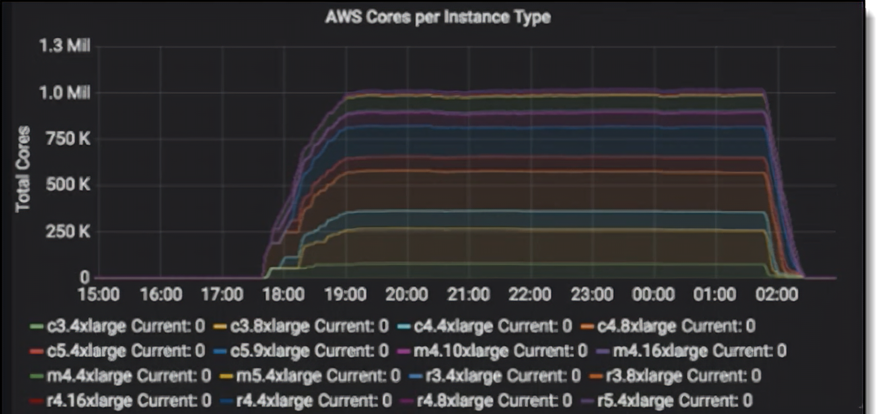

Spare capacity at scale
Over 2.3 million simulation jobs on a
single HPC cluster of 1 million vCPUs
built using Amazon EC2 Spot Instances.
Time to results: 20 Days → 8 hours

Slide 9
EC2 Spot instance pools explained
C5
1a
1b
1c
On
Demand
Each instance family
8XL
$0.50
$0.27
$0.29
$1.76
Each instance size
Each Availability Zone
4XL
$0.21
$0.30
$0.16
$0.88
In every region
Is a separate Spot capacity pool
2XL
$0.08
$0.07
$0.08
$0.44
R5
I3
C4
R4
R5d
XL
$0.04
$0.05
$0.04
$0.22
M5
M4
i3en
R5a
L
$0.01
$0.01
$0.04
$0.11

Slide 10
What about interruptions?
Minimal interruptions Over 95% of the instances were not interrupted in the last 3 months
The work you are doing to make your applications fault-tolerant also benefits Spot
Spot is optimized for stateless, fault-tolerant, or flexible workloads.
Any application that can can have part or all of the work, paused and resumed or restarted, can use Spot.

Slide 11

EC2 Spot Instances - Interruptions
Leverage Instance Metadata Service and Amazon EventBridge notifications
Spot - Instance Termination Notice(ITN) (reactive)
Arrive 2 minutes before your Spot instance is going to be interrupted
Wrap up in 2 minutes
Spot - Rebalance recommendation (RBR) (proactive)
When Spot Instance is at elevated risk of interruption.
Built-in support on EC2 Auto Scaling, Spot Fleet and EC2 Fleet (Proactive replacement)

Slide 12
EKS and EC2 Spot

Slide 13



EKS Cluster Architecture and Node Provisioning
Kubernetes control plane
kubectl
«mycluster».eks.amazonaws.com
Availability Zone 1
Availability Zone 2
Availability Zone 3
Amazon EKS node groups (managed or self-managed)
On-Demand Instance
On-Demand Instance
On-Demand Instance
On-Demand Instance
On-Demand Instance
On-Demand Instance
Spot Instance
Spot Instance
Spot Instance
Spot Instance
Spot Instance
Spot Instance
13

Slide 14
Amazon EKS managed node groups with EC2 Spot
Automatic node provisioning
Support for mixed instance types
Amazon EC2 Auto Scaling group provisioning with capacity-optimized allocation strategy
Automatically configures Kubernetes labels and AWS tags (e.g., cluster autoscaler)
Managed node update and termination
Managed node draining during node termination and updates
Spot Instance lifecycle management
Managed Spot Instance draining integrated with Amazon EC2 Auto Scaling Capacity Rebalancing
Launch template support
Custom configuration and custom AMIs for your Kubernetes nodes
14

Slide 15
Configuring managed node groups
my-cluster-definition.yaml
Attribute Based Configuration
Instance Type Based Configuration
apiVersion: eksctl.io/v1alpha5
kind: ClusterConfig
metadata:
name: my-eks-cluster
region: us-west-2
managedNodeGroups:
- name: my-spot-managed-node-group
desiredCapacity: 2
spot: true
instanceSelector:
vCPUs: 2
memory: 2GiB cpuArchitecture: x86_64
apiVersion: eksctl.io/v1alpha5
kind: ClusterConfig
metadata:
name: my-eks-cluster
region: us-west-2
managedNodeGroups:
- name: my-spot-managed-node-group
desiredCapacity: 2
spot: true
instanceTypes:
- m5.xlarge
- m5d.xlarge
- m4.xlarge
OR
https://eksctl.io/usage/instance-selector/
https://github.com/aws/amazon-ec2-instance-selector
$ eksctl create nodegroup -f my-cluster-definition.yaml
15

Slide 16
EKS managed node group Capacity Rebalancing
t0: Instance gets rebalance recommendation
t1: Replacement Instance is Ready in Kubernetes
t2: Node draining completes
time
Kubernetes node is cordoned and draining starts
Instance is terminated
EC2 Spot Instance at elevated risk of interruption
Kubernetes node drains running pods
Replacement instance is launched
Replacement EC2 Spot Instance
Instance is bootstrapped and registered to Kubernetes
time
Capacity Rebalancing activity
16

Slide 17
Scaling Application and Infrastructure

Slide 18
Auto Scaling the Application & Cluster
HPA (horizontal pod autoscaler)
Autoscales the number of pods in a Deployment/ReplicaSet
CA (cluster-autoscaler)
Autoscales the number of worker nodes in the cluster when:
Pods cannot be scheduled due to lack of resources (Pending state)
Nodes are underutilized and important pods can be rescheduled elsewhere

Slide 19




HPA introduction
If pods are heavily loaded, then starting new pods may bring average load down
If pods are barely loaded, then stopping pods will free resources
Specify the target for the load
Ex: target = CPU utilization 70%
Ex: target = HTTP Requests per minute 10000
Supports – resource metrics (pod resource metrics), custom metrics, or external metrics
Resource metrics: CPU, Memory
Custom metrics: HTTPRequests
85%
90%
93%
88%
TARGET
19

Slide 20
Cluster Autoscaler scale-up
Pending pods
HPA / Application >>
ASG1-m5.xlarge
New nodes
ASG2-m5.2xlarge
Node
1 core request

Slide 21
Going large scale with multiple node groups
Horizontal pod Autoscaler (HPA) – Scales Application
Cluster Autoscaler(CA) – Scales underlying compute infrastructure
Diversification
Divesify nodes within each instance group
Create multiple instance groups with same-size instance types and the same labels / taints
Let the CA random expander span your instances across similar instance groups (i.e., the same labels / taints)
21

Slide 22
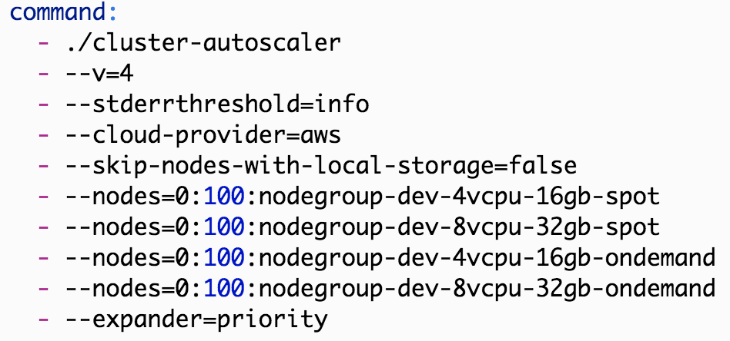
Cluster Autoscaler Priority Expander
apiVersion: v1
kind: ConfigMap
metadata:
name: cluster-autoscaler-priority-expander
namespace: kube-system
data:
priorities: |-
10:
- .*-non-existing-entry.*
20:
- nodegroup-4vCPUs-16GB-Spot
60:
- nodegroup-8vCPUs-32GB-Spot
Improved Mixed Instance Groups, including Scaling to/from 0
Priority Expander: Choose between different Node Groups
--max-node-provision-time flag [Default is 15 Mins ]

Slide 23
Karpenter for Groupless provisioning and Autoscaling
What if we remove the concept of node groups?
Choose instance types from pod resource requests
Choose nodes as per pod scheduling constraints
Provision capacity directly - EC2 “Instant” Fleets
Track nodes using native Kubernetes labels
Bind pods early to provisioned nodes
23

Slide 24




How Karpenter works
Karpenter works in tandem with Kube- scheduler and Compute provider
Kube scheduler gets the first crack at scheduling pending pods on existing capacity
Karpenter observes aggregate resource requests of unschedulable pods, computes and launches best-fit new capacity
Karpenter terminates empty nodes
Pending pods
Existing capacity
Unschedulable pods
Just-in-time capacity
24

Slide 25
How Karpenter provisions nodes on AWS
Application Scheduler/HPA
Pending Pods
CA
ASG
EC2 API
EC2 Fleet
(Instance)
Karpenter

Slide 26
Tools

Slide 27

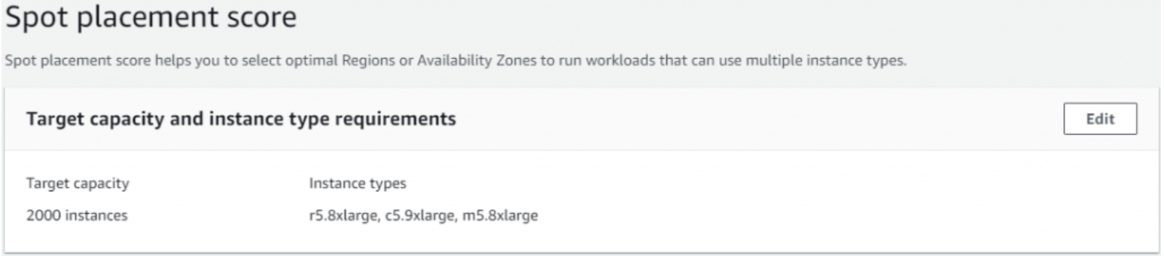
Spot Placement Score
New!
Input desired amount of Spot capacity needed
Input instance types needed
Select Region, AZs
Placement Score 1 to 10 (10 being highly available)

Slide 28
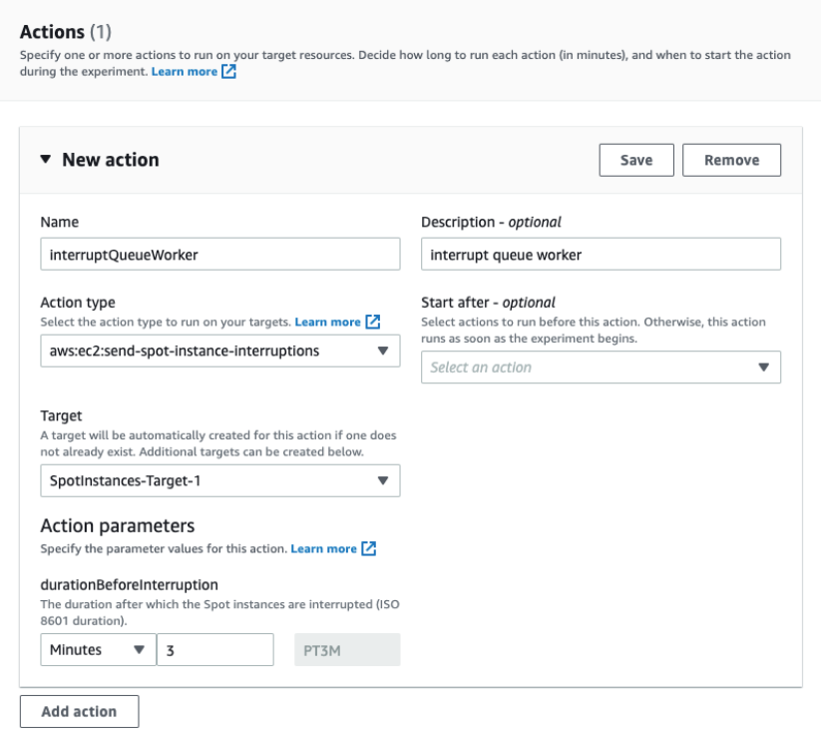
Fault Injection Simulator – for EC2 Spot
New!
Simulate Spot Instance Termination Notice (ITN)
Simulate Spot Rebalance Recommendation Notice (RBR)
Validate your application fault tolerance on Pre-Prod
Create Experiment template once and run many times
Duration Before Interruption Parameter determines to provide RBR or ITN or Both
Duration of more than 2 minutes generate both signals

Slide 29
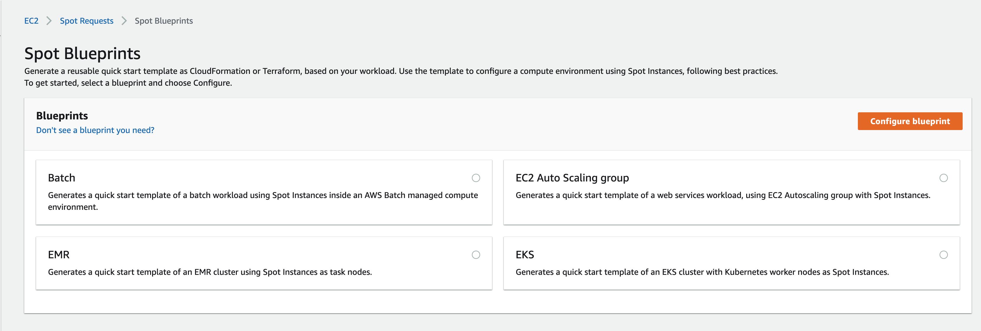
Spot Blueprints
Infrastructure code template generator
Lives right in the EC2 Spot Console
Currently generates templates for AWS Batch, EC2 AutoScaling, EMR and EKS
Implements Spot Best practices
Option to deploy the templates directly from the same Spot Console Or Download, then modify then Deploy
Both CloudFormation and Terraform Templates are supported now

Slide 30
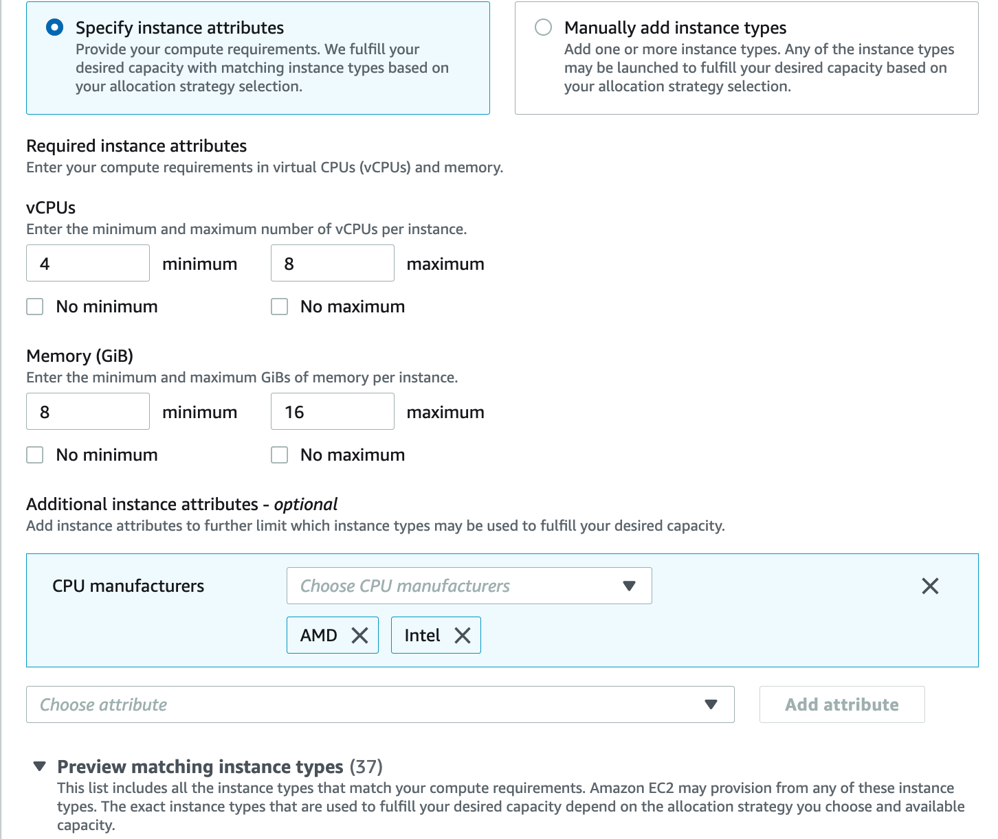
Attribute Based Instance Selection
Provision capacity based on instance attributes such as CPU/Memory
Supports new instances as soon as they become available

Slide 31
Graviton

Slide 32




Broadest choice of processors
Intel® Xeon Scalable processors
AMD EPYC processors
AWS Graviton processors

Slide 33

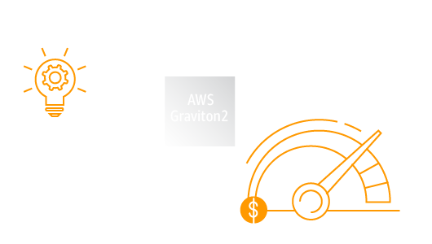
AWS Graviton Processors
Custom AWS silicon with 64-bit Arm processor cores
Targeted optimizations for cloud-native workloads
Rapidly innovate, build, and iterate on behalf of customers

Slide 34
Lower TCO with Graviton2-powered instances
Highest performance
in their instance families
20% lower cost
vs same-sized comparable fifth generation instances
Up to 40% better price-performance
vs comparable x86-based instances
Best price-performance within their instance families

Slide 35
Announcing AWS Graviton3 and Amazon EC2 C7g instances
Enabling the best price performance for workloads in Amazon EC2
Up to 25% better performance compared to Graviton2
Up to 2x higher floating-point performance, up to 2x faster cryptographic workload performance, and up to 3x better machine learning performance compared to Graviton2
NEW!
First in the cloud to feature DDR5 memory
60% more energy efficient over comparable EC2 instances
C7g instances, available in preview, will provide the best price performance for compute-intensive workloads in Amazon EC2
https://aws.amazon.com/blogs/aws/join-the-preview-amazon-ec2-c7g-instances-powered-by-new-aws-graviton3-processors/

Slide 36
AWS Graviton ease of adoption
Difficulty | Workload | Actions
Virtually no effort | RDS, Aurora, ElastiCache, OpenSearch, MemoryDB, & Neptune | Upgrade to latest and enjoy
Super easy | EMR | Typically, just works
Pretty easy | AWS Lambda | Typically, just works with Lambda managed runtimes or base images. Watch: JNI or Python-native modules
Quite easy | Linux – Interpreted and JIT’d languages (e.g., Java, PHP, Node.js) | Select Arm64 AMI and Install Bonus if containerized Watch: JNI or Python-native modules
More involved | Linux – Compiled languages (e.g., C/C++, Python, Go) | Select Arm64 AMI and compile Watch: port any intrinsics or assembly
Some work, high reward | Microsoft Windows – .NET | Migrate to Linux + .NET core on Arm64
Sorry, not yet | Microsoft Windows | Microsoft Windows Server not yet available for arm64

Slide 37
Questions?

Slide 38
Douglas Ramiro
douglars@amazon.com

